Slide 1
Welcome To Our Presentation

Slide 2
Project Title:
Point Of Sale System
Group Member:
Name | ID
Md. Jusef | 2017-2-60-160
Md. Salauddin Mozumder | 2017-2-60-167

Slide 3
Wrong Password
Start
Input username and password
Yes/no
Dashboard
Purchase product for customer
yes
Calculate
Payment
Generate Receipt
Figure: User Flow/Flow Chart Diagram

Slide 4
SERVICE RECEIPT
SALES & SERVICE RECEIPT
POS SYSTEM
ADMIN
STAFF REGISTRATION
STAFF LOG IN
STAFF
PROUCT PURCHASE
PRODUCT PURCHASE & SERVICE
SERVICE RECEIPT
CUSTOMER
SALES AND SERVICE RECEIPT
Figure: Context Diagram

Slide 5
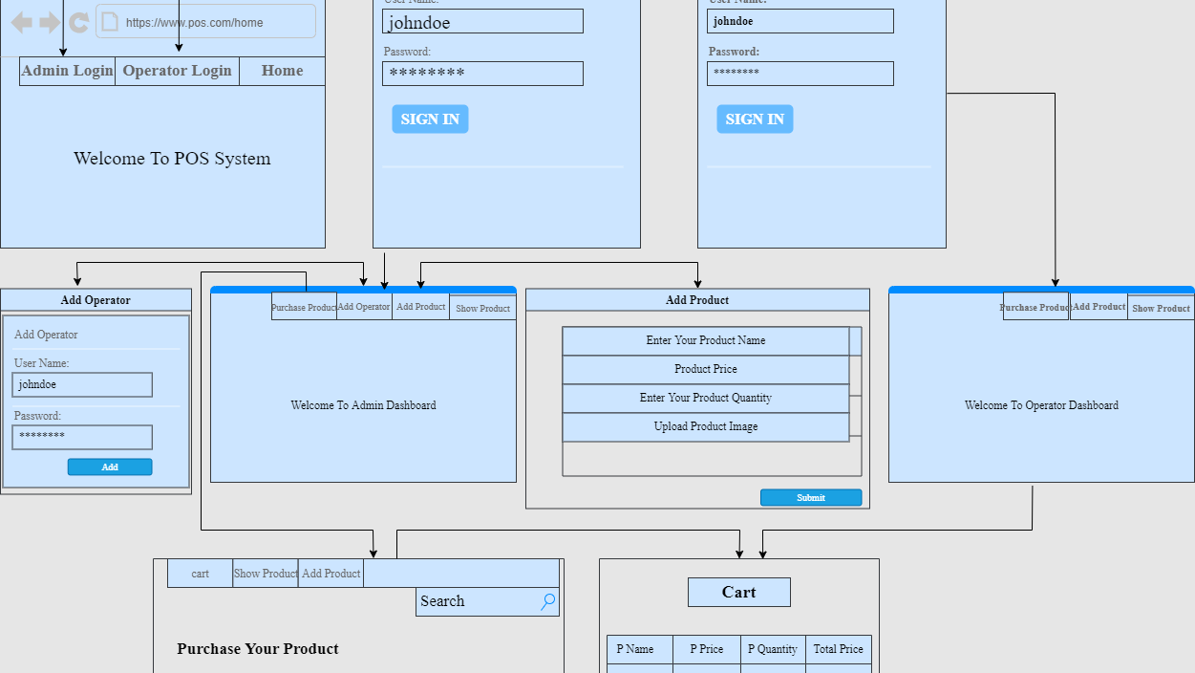
Figure: Wireframe Diagram

Slide 6
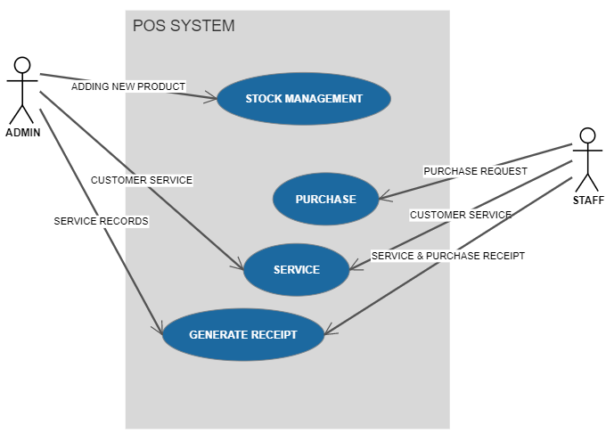
Figure: USE CASE DIAGRAM

Slide 7
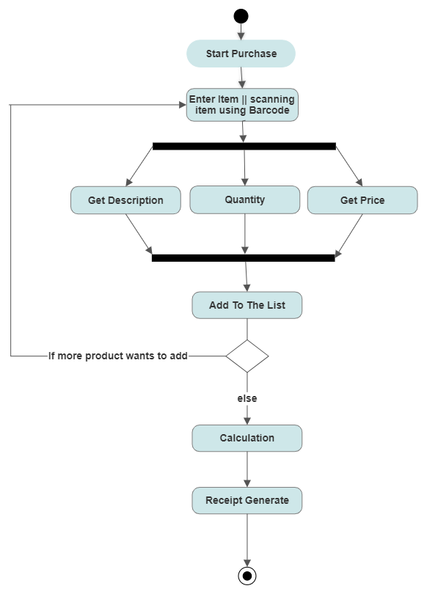
Figure: Activity Diagram for Purchase

Slide 8
Thank You

